Slide 1
Consumer Goods Ad_Hoc Insights
SQL Project Challenge
Domain – Consumer Goods
Presenter : Janak Ram

Slide 2

Introduction
Atliq Hardware (imaginary company) is one of the leading computer hardware producers in India and well expanded in other countries too. However, the management noticed that they do not get enough insights to make quick and smart data-informed decisions. They want to expand their data analytics team by adding several junior data analysts. Tony Sharma, their data analytics director wanted to hire someone who is good at both tech and soft skills. Hence, he decided to conduct a SQL challenge which will help him understand both the skills.

Slide 3
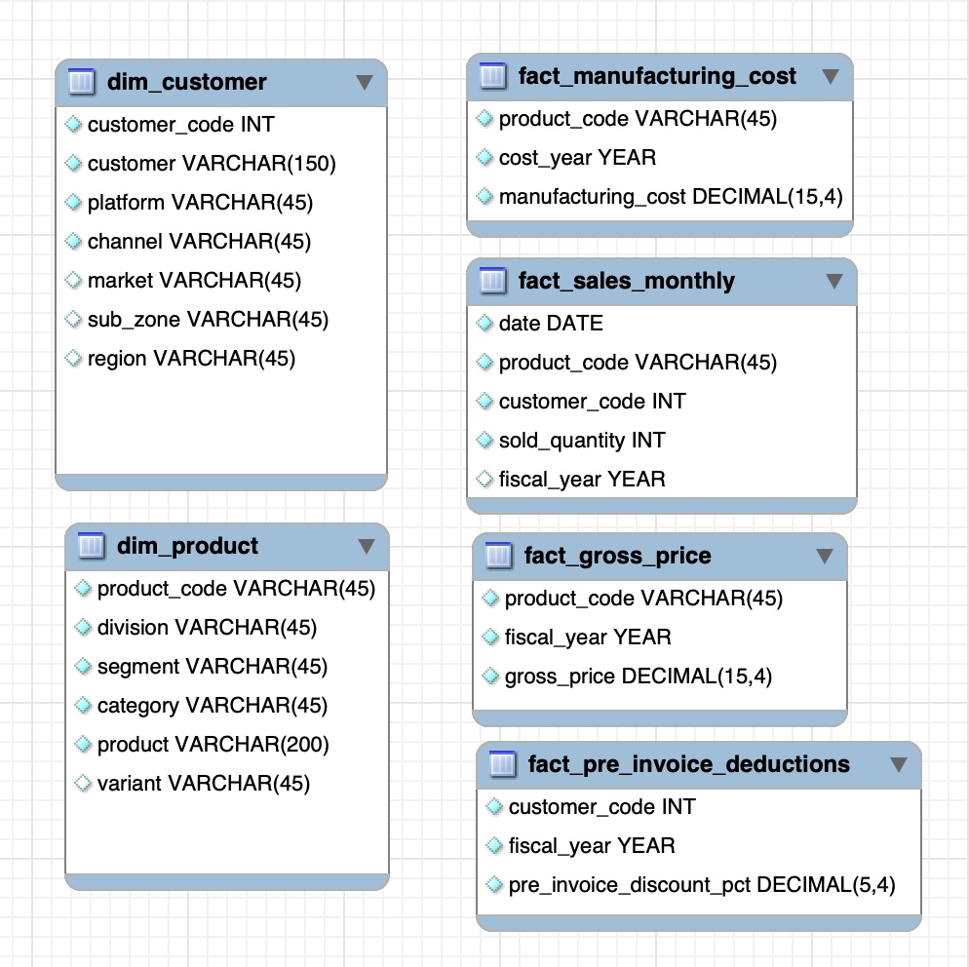
Understanding Data
This database has 6 tables from which two dimensional tables and other ones are fact tables.
The dataset only contains observations for the years 2020 & 2021

Slide 4
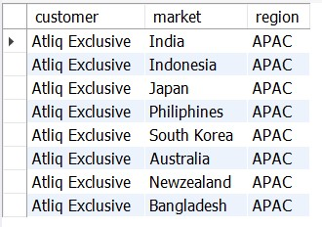
Request 1
Question
Provide the list of markets in which customer "Atliq Exclusive" operates its business in the APAC region.
Output

Slide 5

Request 2
Question
What is the percentage of unique product increase in 2021 vs. 2020? The final output contains these fields:
unique_products_2020
unique_products_2021
percentage_chg
Output

Slide 6
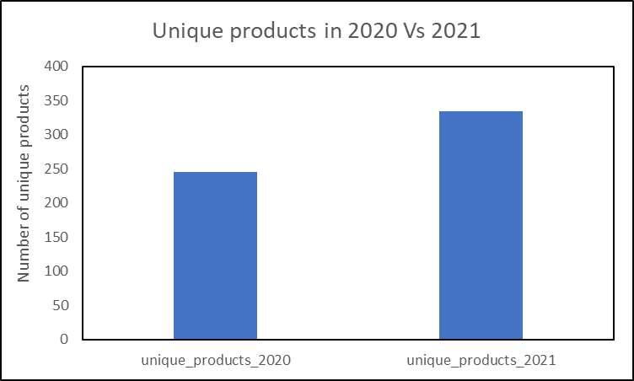
Insights
The unique products increased by 36% in 2021 compared to 2020

Slide 7
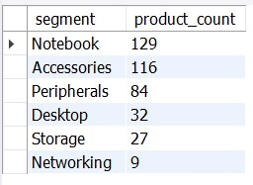
Request 3
Question
Provide a report with all the unique product counts for each segment and sort them in descending order of product counts. The final output contains two fields:
segment
product_count
Output

Slide 8
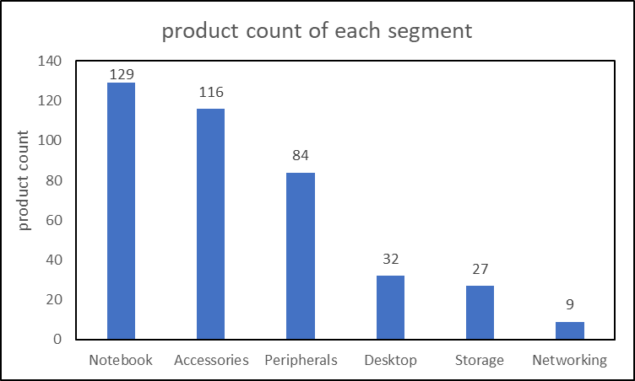
Insights
Notebook segment has more unique products and networking segment has less number of
unique products

Slide 9
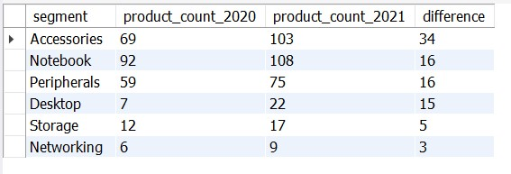
Request 4
Question
Follow-up: Which segment had the most increase in unique products in 2021 vs 2020? The final output contains these fields:
segment, product_count_2020
product_count_2021, difference
Output

Slide 10
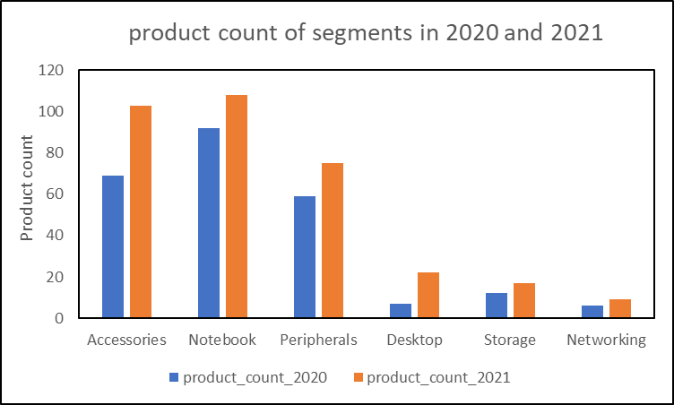
Insights
Accessories segment has more difference in unique products than remaining segments
Networking segment has least difference in unique products

Slide 11

Request 5
Question
Get the products that have the highest and lowest manufacturing costs. The final output should contain these fields:
product_code, product, manufacturing_cost
Output
AQ HOME Allin1 Gen 2 product has high manufacturing cost
AQ Master wired x1 Ms product has low manufacturing cost

Slide 12
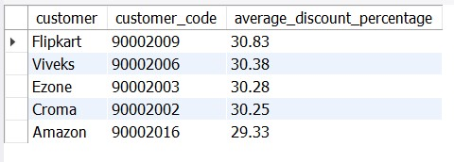
Request 6
Question
Generate a report which contains the top 5 customers who received an average high pre_invoice_discount_pct for the fiscal year 2021 and in the Indian market. The final output contains these fields:
customer_code, customer, average_discount_percentage
Output

Slide 13
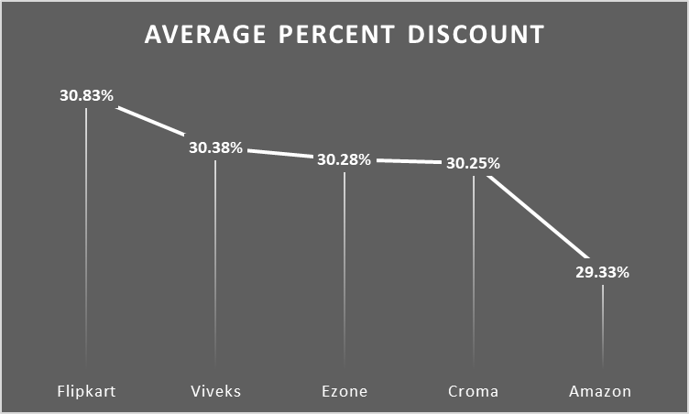
Insights
Top 5 customers in Indian market are Flipkart, Viveks, Ezone, Croma and Amazon
Flipkart has slightly more discount percent compared to remaining 4 customers

Slide 14
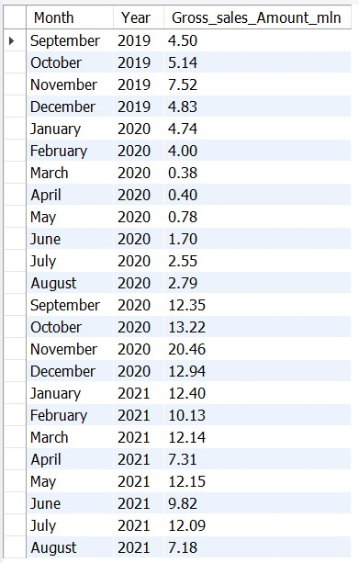
Request 7
Question Output
Get the complete report of the Gross sales amount
for the customer “Atliq Exclusive” for each month.
This analysis helps to get an idea of low and
high-performing months and take strategic decisions.
The final report contains these columns:
Month
Year
Gross sales Amount

Slide 15
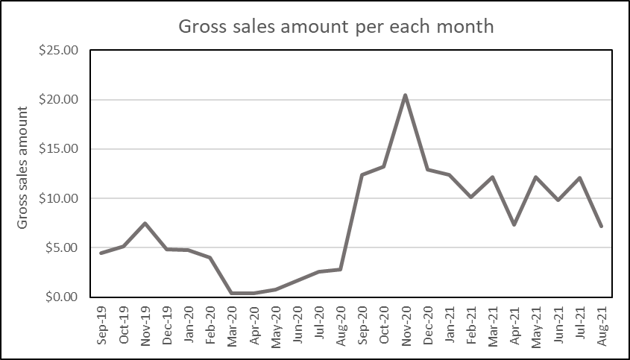
Insights
In the fiscal year 2020, the highest gross sale is 7.52 million dollars
Gross sales increased tremendously in the fiscal year 2021 with highest gross sales of
20.46 million dollars.

Slide 16
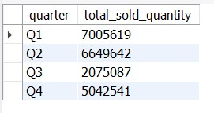
Request 8
Question
In which quarter of 2020, got the maximum total_sold_quantity? The final output contains these fields sorted by the total_sold_quantity:
Quarter
total_sold_quantity
Output

Slide 17
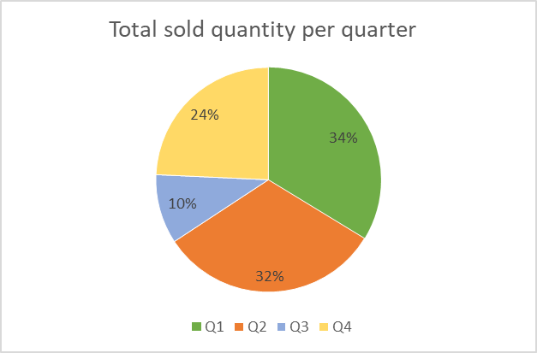
Insights
Quarter 1 has more total sold quantity with 7 million
Quarter 3 has low total sold quantity with 10%

Slide 18
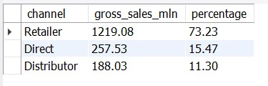
Request 9
Question
Which channel helped to bring more gross sales in the fiscal year 2021 and the percentage of contribution? The final output contains these fields:
channel
gross_sales_mln
percentage
Output

Slide 19
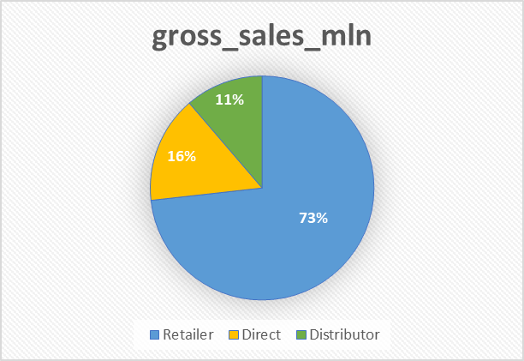
Insights
Retailer channel helps to bring more gross sales with 73.23% in fiscal year 2021

Slide 20
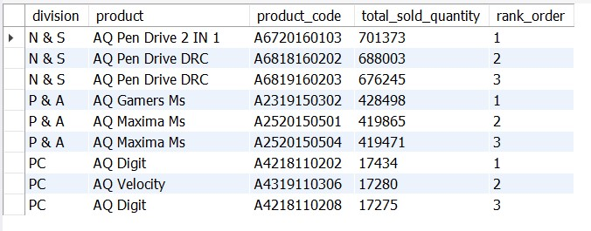
Request 10
Question
Get the Top 3 products in each division that have a high total_sold_quantity in the fiscal_year 2021? The final output contains these fields:
division
product_code
Output

Slide 21
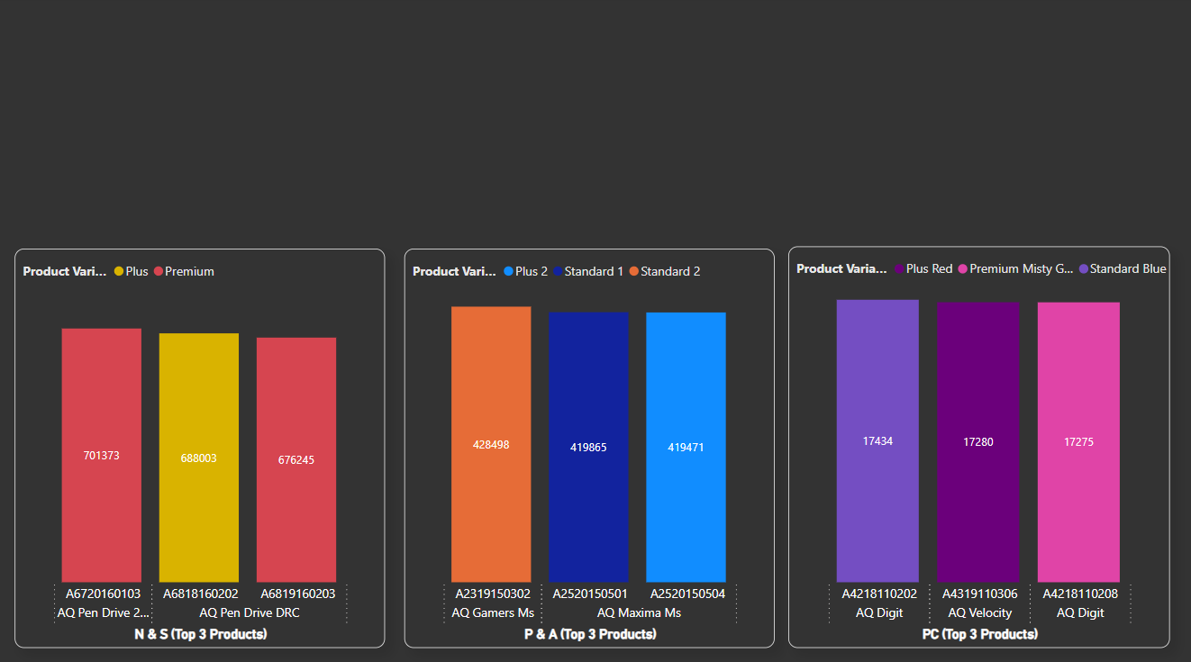
In N&S division, top 3 products are Pen drives and their sales are more than the other two division products
Top 3 products in P&A division are mouses and in PC division are personal computers

Slide 22


Thank you
Thanks to your valuable time and please share your thoughts, suggestion, improvement points in the comments section
www.linkedin.com/in/janak-ram101

